Slide 1
Mutual Aid Database
Milestone 1.0
Application by: Dolma Rawat, Daniel Pham, Soren Laskin & Komi Adomayakpor

Slide 2
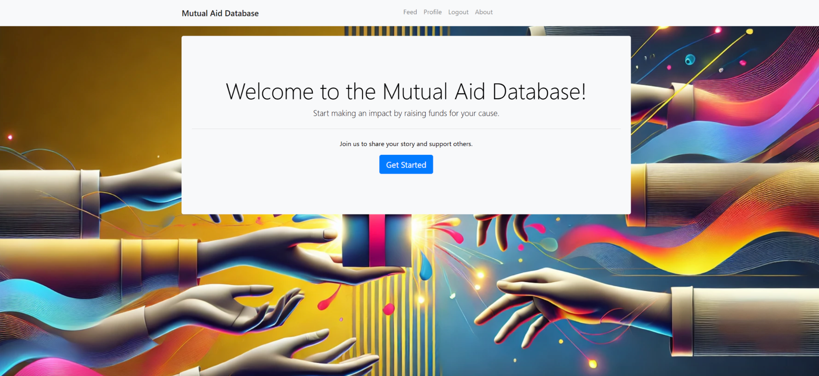
About Mutual Aid Database
Our Software?
A platform to facilitate assistance for individuals & communities affected by crises such as wildfires and/or any type of natural disasters.
Objective: Allow users to create listings for financial assistance and enable donuts to choose whom to support.

Slide 3
Design Mockup & Milestone 1 objectives
Mutual Aid Database
Home/ About Us
No
Register
Your Feed (Create/Edit Post)
Login
Account?
Yes
List of all the posts

Slide 4
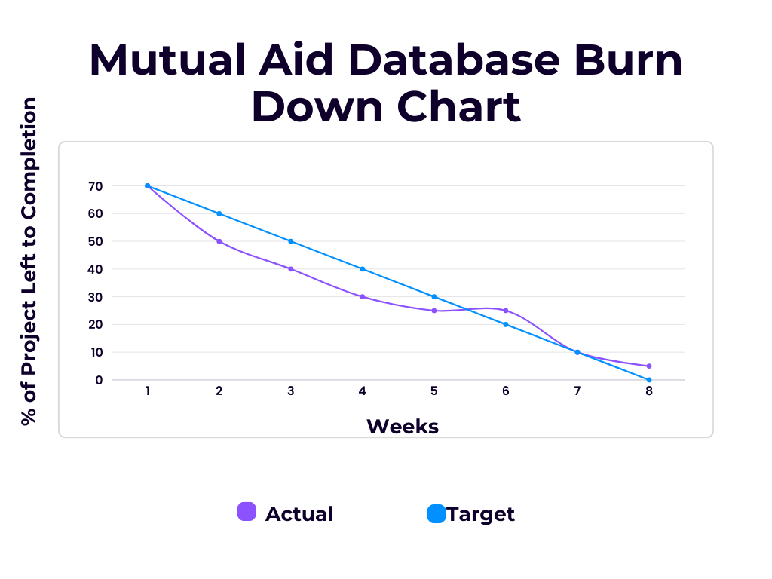
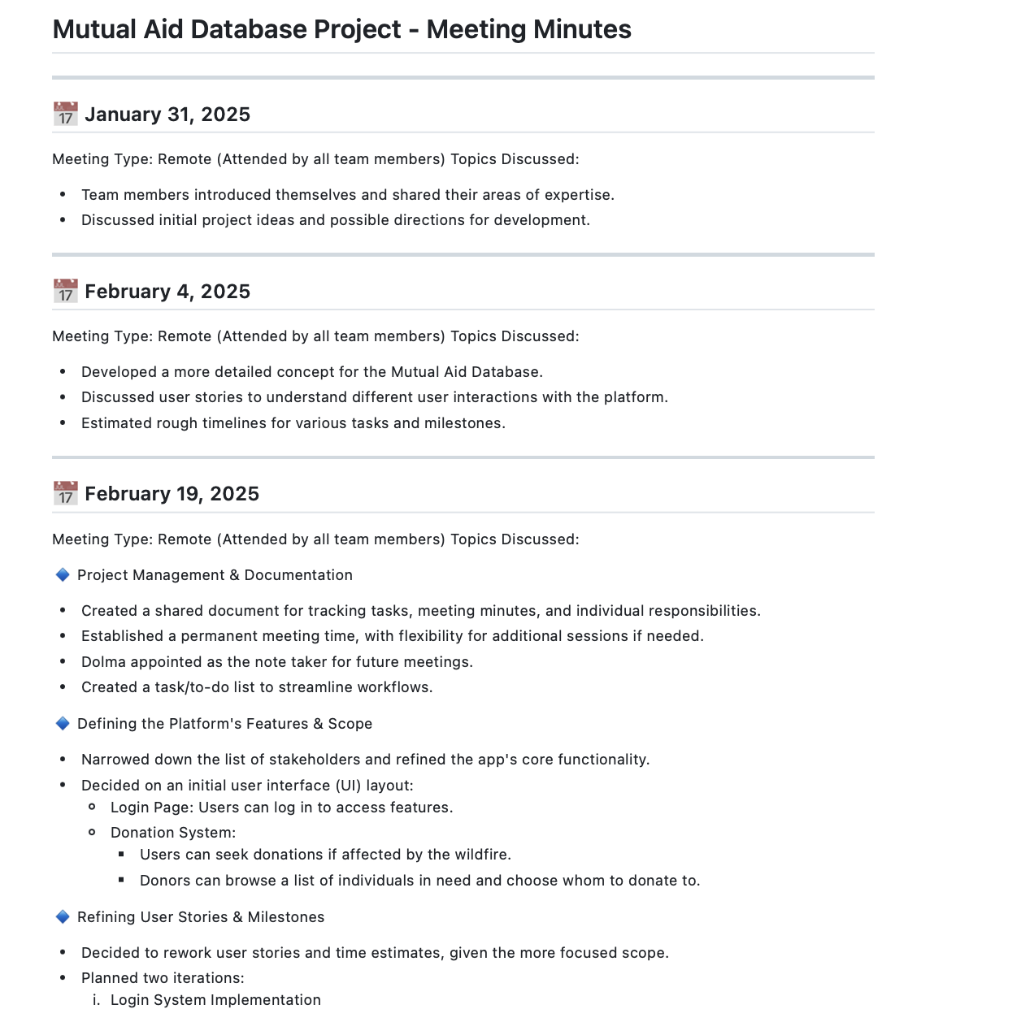
Agile Practices
Used Extreme Programming for our project:
Short 1–2 week iterations for rapid development
Continuous planning & refining user stories
Pair programming for collaboration & knowledge sharing
Small, frequent releases with Continuous Integration (CI/CD)
Collective code ownership to ensure flexibility & maintainability
Key Implementations in Our Project:
Iteration 1: Built login system, tested authentication flow
Iteration 2: Developed donation request page & registration functionality
Used Test Driven Development to validate user inputs & database operations
Constant updates on user functionality and code efficiency to satisfy user stories

Slide 5
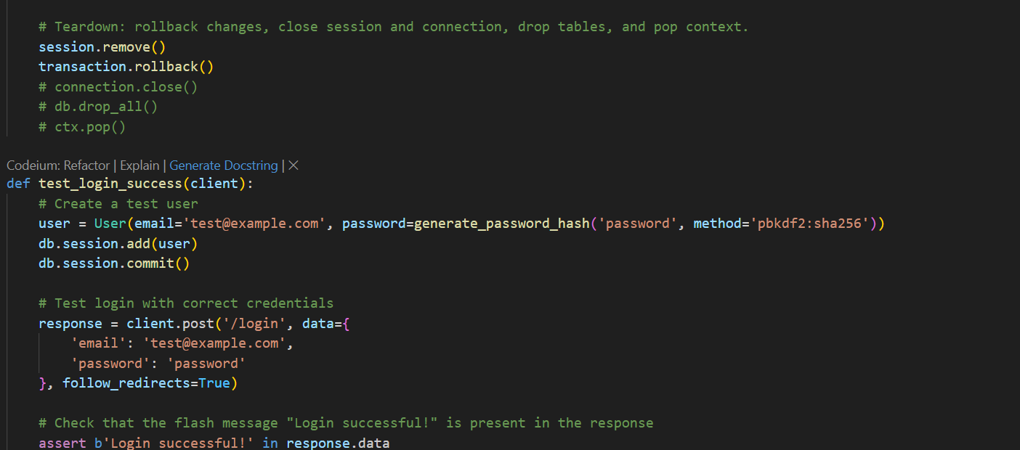
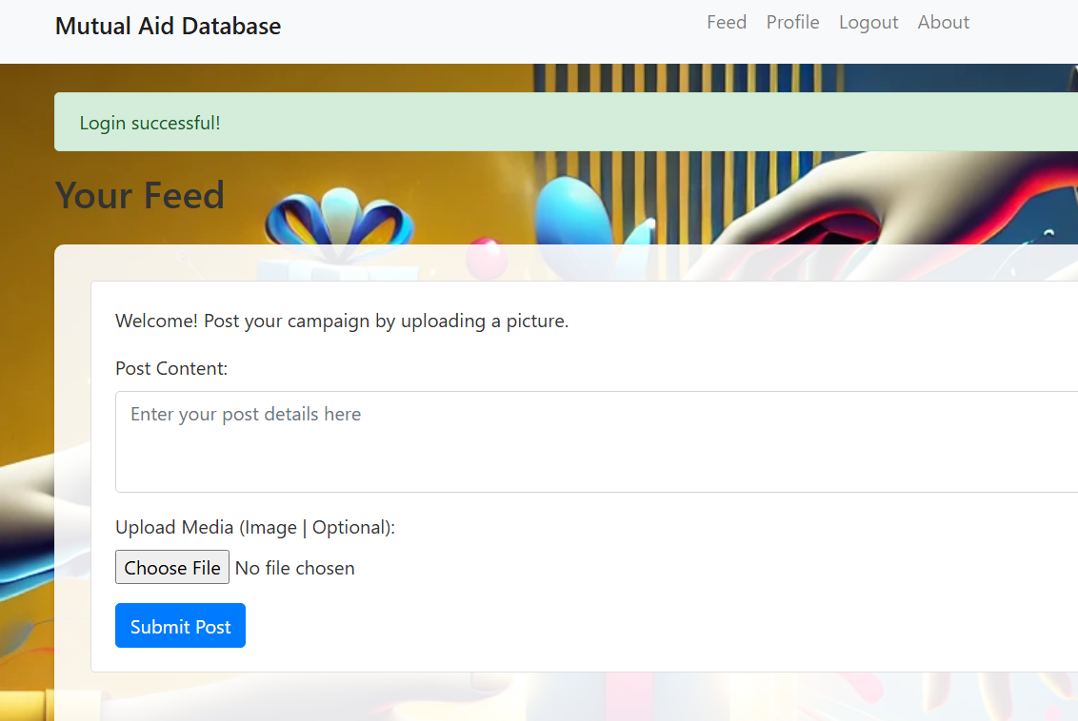
How the Code Fulfills the User Stories
As a user affected by a natural disaster, I want to be able to login and have my own account that saves my posts and preferences.

Slide 6
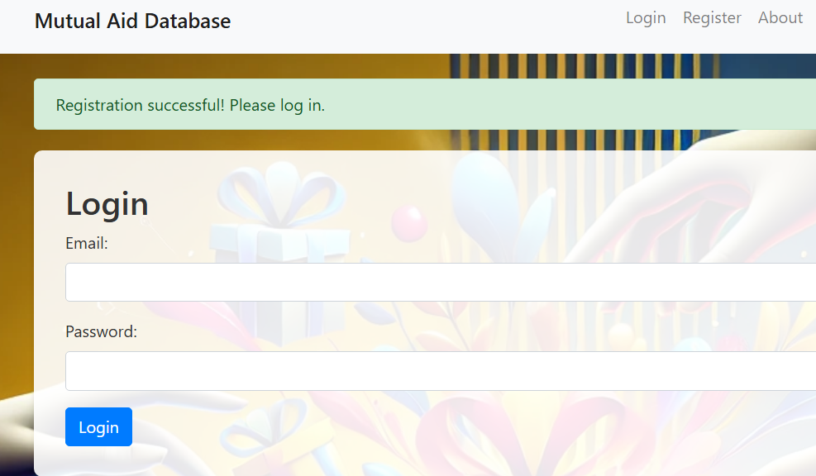
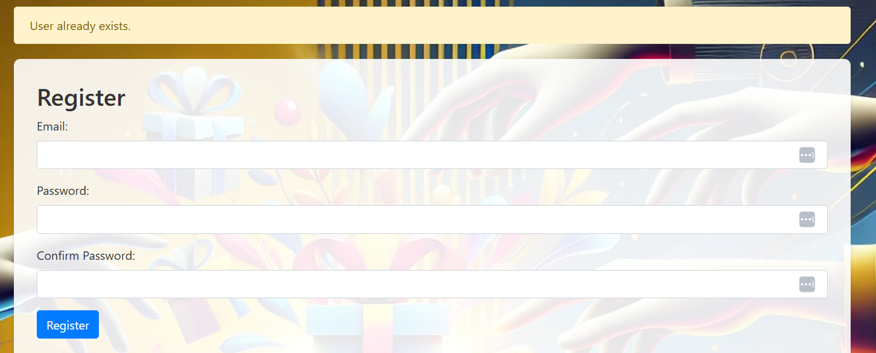
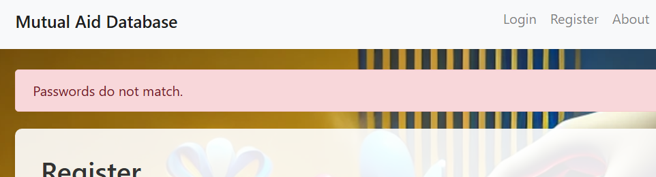

Slide 7

As a user affected by a natural disaster, I want to post a fundraising campaign with a title, description and percentage towards financial goal.
As a user affected by a natural disaster, I want to upload images to further showcase my struggle and trustworthiness

Slide 8
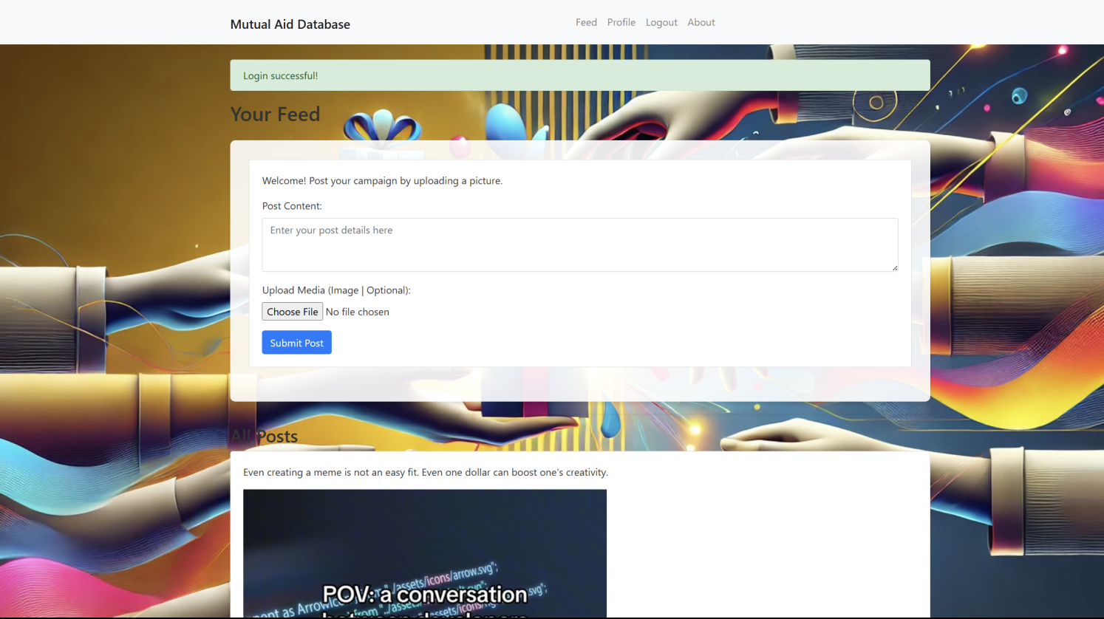
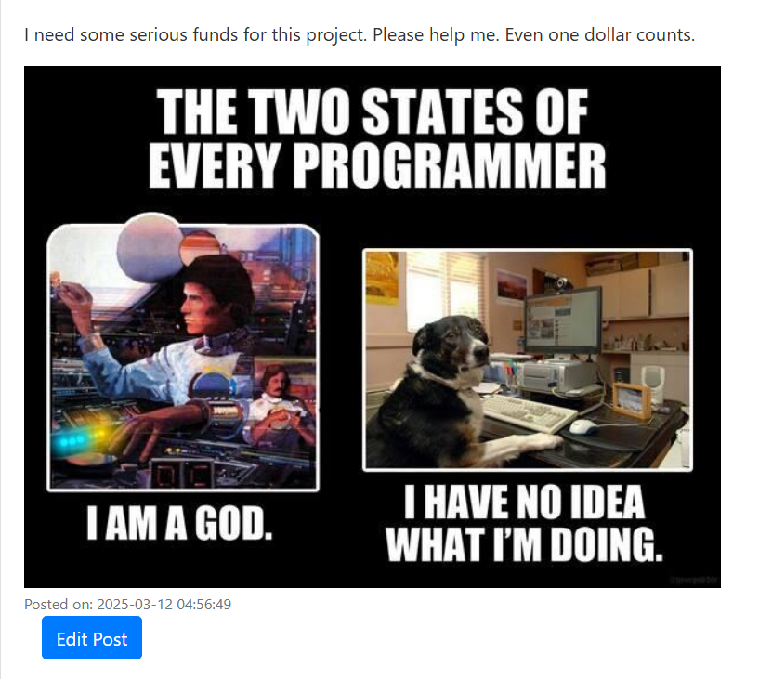
As a user affected by a natural disaster, I wish to provide an update to my posting as situations change and I can show donors how their donations have helped

Slide 9



Preparing for Milestone 2
Milestone 1
Some objectives to complete for milestone 2 include:
Stakeholder feedback form to collect data and assess functionality and login security of current project state
Add more features to database- working on web design,
Continuing to test login functionality/security
Continuing to test different variables in creating and donating to listings
Milestone 2
Milestone 3

Slide 10
Thank you!
Any Questions?

